Slide 1
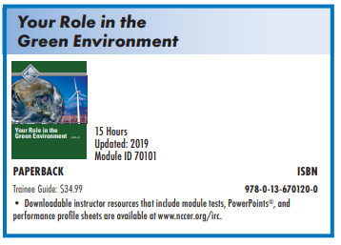
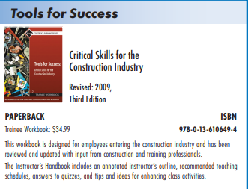
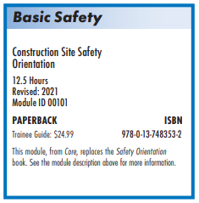
NCCER - CORE
6 Industry
Credential Points
NCCER Core is designed as a rigorous, competency-based, industry-recognized program for career and technical education. Students may complete the required elements sooner or later than the recommended 150 hours of knowledge and skills-based instruction, depending on their individual proficiency in mastering the content.
NCCER Core is a prerequisite to all other Level 1 craft curriculum. Its modules cover topics such as Basic Safety, Communication Skills and Introduction to Construction Drawings.

Slide 2
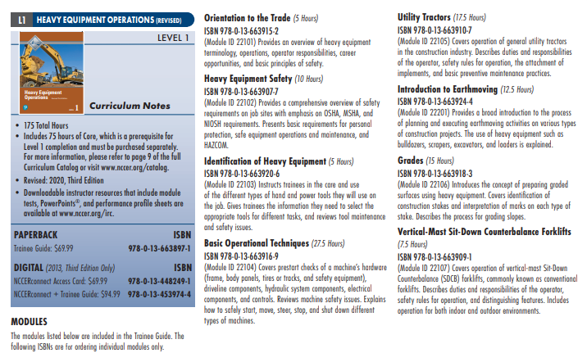
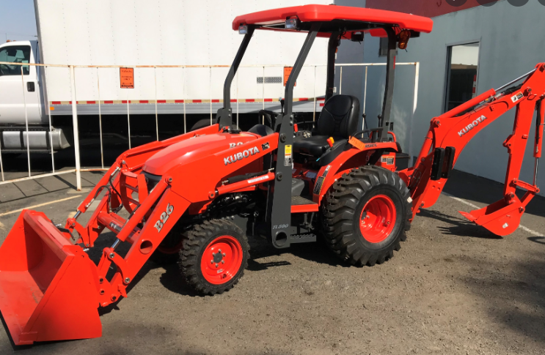
NCCER – Heavy Equipment
500-hour program
Heavy equipment operators (HEO) not only work on regular construction building jobs, but also on infrastructure projects (roads, bridges, and ports, otherwise called non-building construction), and in mining and timber operations. A trained and experienced equipment operator provides necessary skills for any project that requires moving and transporting heavy materials, or that demands any kind of earthmoving.
What students actually learn on

